Slide 1

MUSIC STORE
ANALYSIS

Slide 2
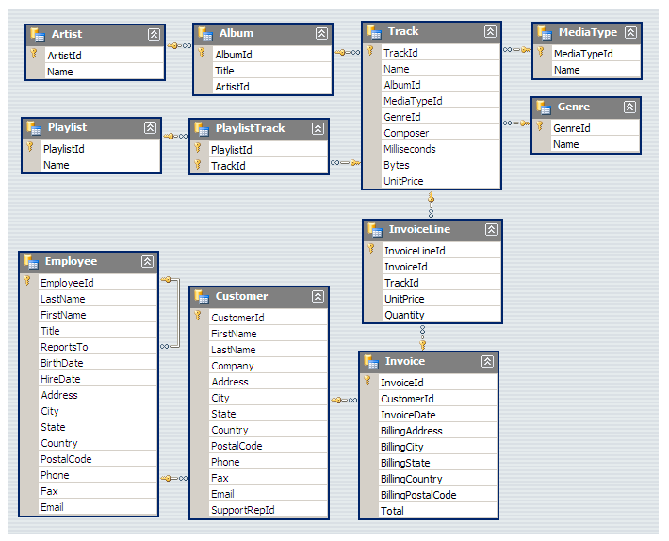
DATA

Slide 3


MUSIC STORE ANALYSIS

Slide 4



Slide 5


Slide 6
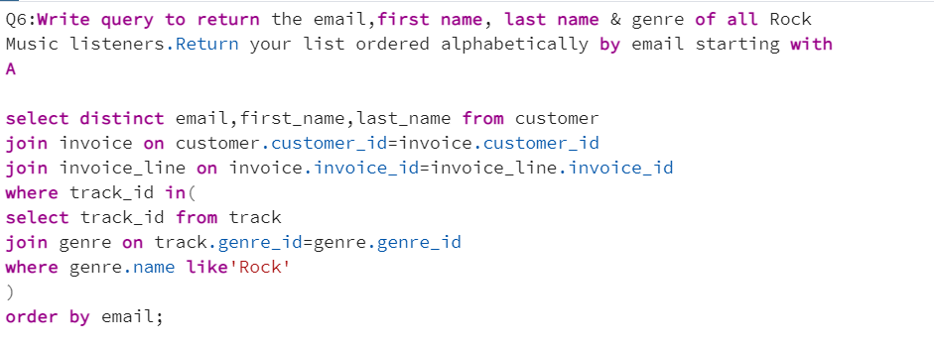

Slide 7


Slide 8


Slide 9
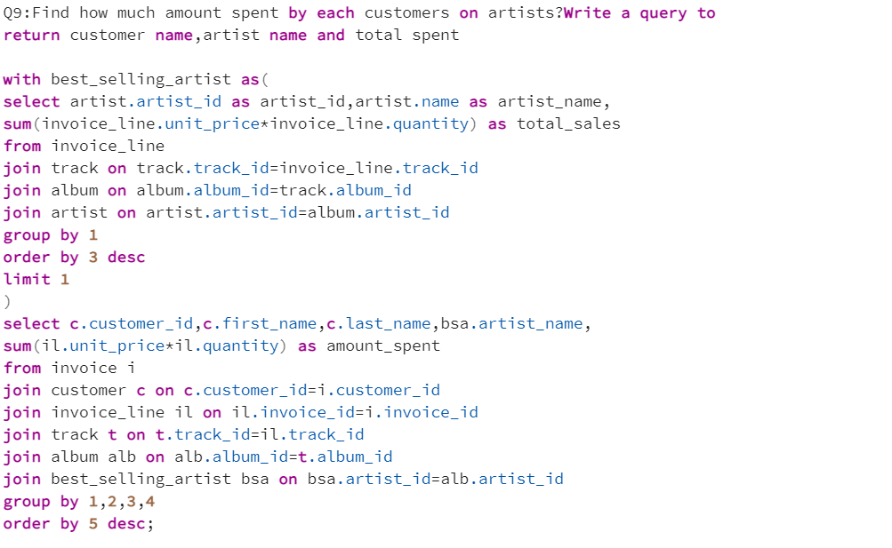

Slide 10
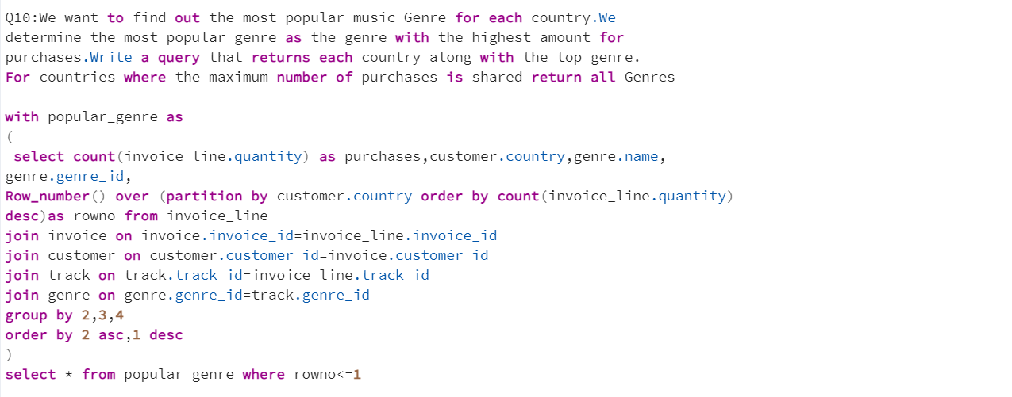

Slide 11
